Slide 1


ONLINE SHOPPING

Slide 2
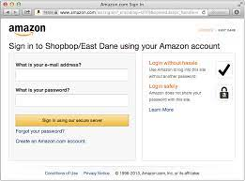
LOGIN ENTER CREDENTIALS
WELCOME TO OUR WEBSITE
SEARCH YOUR PRODUCT
CLICK ON THE PRODUCT
ADD TO CART OR BUY
ADDRESS
PAYMENT OPTIONS
DELIVERY

Slide 3

THANK YOU
VISIT AGAIN

